Slide 1
Fillet
- -
MATIC
Eric King
Alejandra Valdivia

Slide 2
The Problem:
1,215
Seafood
Samples
674
Retail
outlets
21
States
33% mislabeled
Data from Oceana 2010-2012
Notes:
http://www.npr.org/sections/thesalt/2013/02/21/172589997/one-in-three-fish-sold-at-restaurants-and-grocery-stores-is-mislabeled
This is the link of the new. We actually have the pdf with the inform form Oceana.
Between 2010 and 2012, Oceana took 1,215 seafood samples from 674 retail outlets in 21 states. When they tested the DNA, they found that 33 percent were mislabeled. Sushi vendors and grocery stores were the most likely outlets to sell mislabeled food, though Oceana says the fraud can happen before it reaches them.
Some 49 percent of the retail outlets sampled in Austin and Houston sold mislabeled seafood, while 36 percent in Colorado did so.
a cheap fish like tilapia sold as red snapper. But Oceana says the practice also can put consumers at health risk when species like king mackerel, which is high in mercury, or escolar, which contains a naturally occurring toxin than can cause gastrointestinal problems, are marketed as grouper and white tuna, respectively.

Slide 3
The Problem:
Obligatory labeling regulations exist but the implementation fails since there is not technical capacity to identify fish after it is cut.
Distributors
Retailers
Restaurants
Governmental
Oversight
Consumers
IDENTIFICATION
INSPECTION
Notes:
The obligatory Labeling regulation exist but the implementation fails since there is not technical capacity to identify the product that they receive from their vendors and because there is also imposible to inspect every single imported fish that arrive
90% of the seafood in USA is imported and from that only 2% is inspected.

Slide 4
Relevance:
$
Tilapia Red Snapper
Escolar White Tuna
Vulnerable
Species
Extinction
Notes:
This affect consumer rights and fare trade since generally the consumer ends up paying a higher price for a low value specie such as Tilapia.
It also represent a health risk when species like Escolar , which contains a naturally occurring toxin than can cause gastrointestinal problems, are marketed as white tuna
The Consumer

Slide 5
The Solution:
$
Easy identification of fish fillets by picture/database
Feedback to Governmental entities
Fillet
-o-
Needed resources:
MATIC
Dataset of verified images to cross reference submissions.

Slide 6
The Model:
FEEDBACK
FEEDBACK
Consumer
Retailer
Governmental
oversight
Weekly stats:
Retails with mislabeled fish Country of Origen: Endangered Species:

Slide 7

Demo

Slide 8
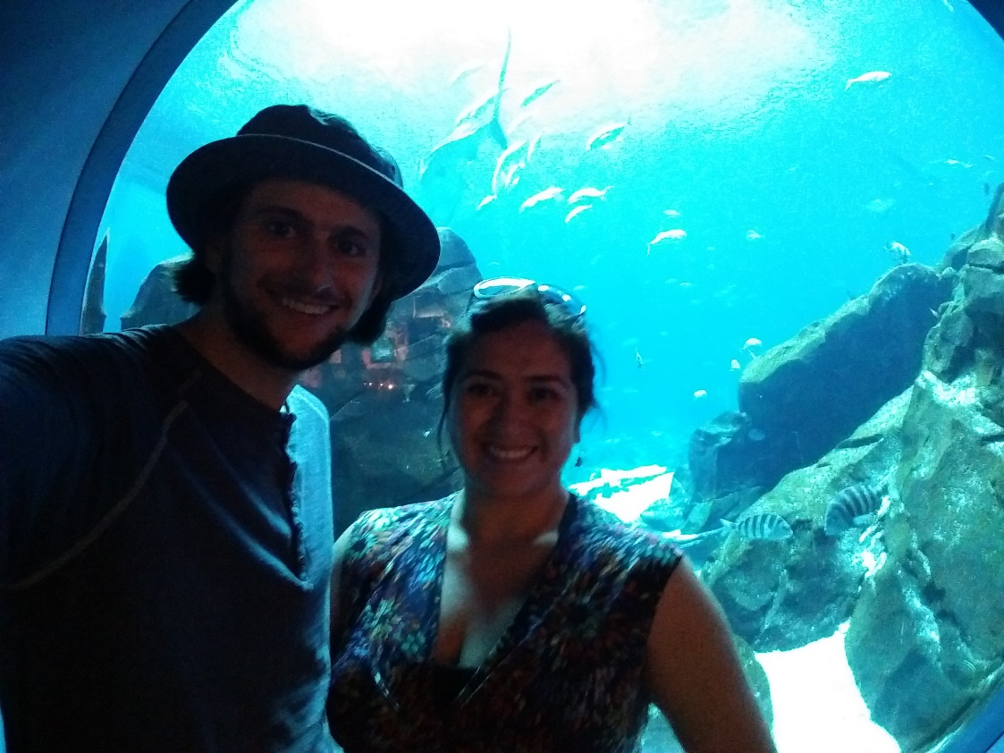
Our Team:
Fillet
- -
MATIC
Thanks!
Eric King
Alejandra Valdivia

